Slide 1
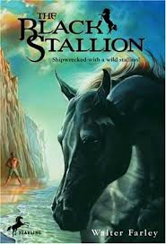
The Black Stallion
By Walter Farley
Text Talk
Bonnie Grimes Elementary

Slide 2
Chapter 1

Slide 3
Monotonously- not interesting because of having to do the same thing over and over again.

Slide 4
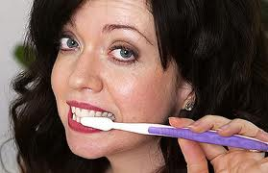
Word in context: “The captain and crew were kind to Alec, but the days passed monotonously for the homeward-bound boy as the Drake steamed it’s way through the Gulf of Aden and into the Red Sea.
Another example: Jill monotonously brushed her teeth.

Slide 5
Barren- not able to produce or support growth

Slide 6
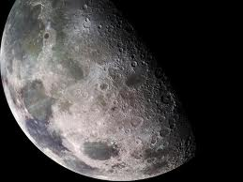
Word in context: “The Drake kept near the coast of Arabia- endless miles of barren desert ashore.”
Another example: The moon is barren and without life.

Slide 7
Tersely- brief or concise to the point of rudeness

Slide 8
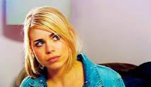
Word in context: “Alec saw a dark-skinned man, wearing European dress and a high, white turban, giving directions. In his hand he help a whip. He gave orders tersely in Arabic.”
Another example: The teenager answered her mom tersely, on the verge of being rude.

Slide 9
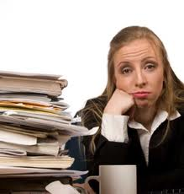
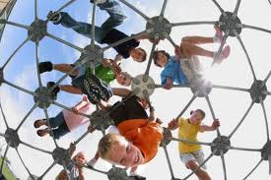
What is something that you might do monotonously?
Play at recess or do your homework?

Slide 10
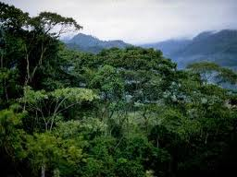
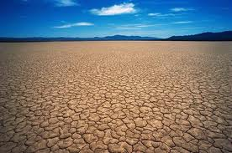
Which picture shows “barren”?

Slide 11
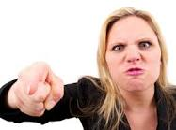
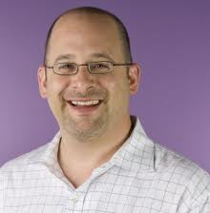
Which person is speaking tersely?

Slide 12
Chapter 6

Slide 13
Bedlam- a situation or scene of confused disorder and uproar

Slide 14
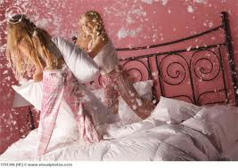
Word in context: “When Alec entered the hold, he heard the Black’s pounding above the bedlam of the other horses and cattle.”
Another example: The pillow fight caused bedlam at the slumber party.

Slide 15
Uncanny- something odd, mysterious, or unexpected that makes you feel uneasy

Slide 16
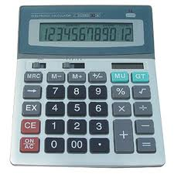
Word in context: The captain’s hand rose to his chin as he and Pat watched Alec inside the stall. “Y’know, Pat, “ he said, “it’s almost uncanny the way those two get along- a wild beast like that, a killer, and yet gentle as a kitten when the boy’s around.”
Paul had an uncanny ability to calculate long division problems in his head without the use of a calculator.

Slide 17
Supremacy- the state of being dominant

Slide 18
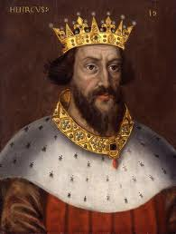
Word in context: “Sounds of hoofs striking bodies, and squeals of terror from the other horses mingled with the screams of the two savages who fought for supremacy.”
Another example: The King had great supremacy over his kingdom.

Slide 19
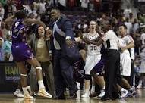
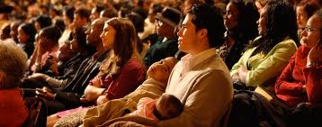
Which picture depicts bedlam?

Slide 20
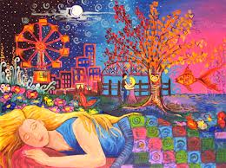
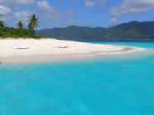
Which would be uncanny?
Dreaming about something that later came true. or
Going on a trip to the beach.

Slide 21
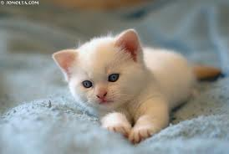
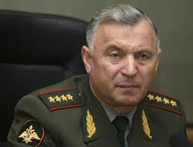
Which picture shows supremacy?

Slide 22
Chapter 14

Slide 23
Momentum- the amount of motion occurring in something that is moving.

Slide 24
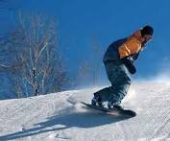
Word in context: “Suddenly he let loose on the reins and the stallion bolted. He gained momentum in mighty leaps.”
Another example: The snowboarder gained momentum as he traveled down the huge hill.

Slide 25
Ponderously- awkward because of weight or size

Slide 26
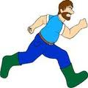
Word in context: “Napoleon trotted ponderously, his eyes straight on the track ahead of him.”
Another example: The giant ran ponderously through the forest.

Slide 27
Conscientiously- careful, precise

Slide 28
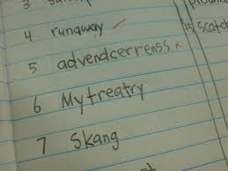
Word in context: “Weeks passed, and Alec and Henry conscientiously trained the Black.”
Another example: During the spelling test, Diana conscientiously wrote each word correctly and neatly.

Slide 29
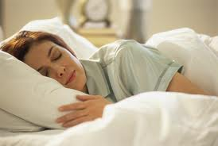
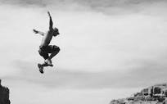
Which picture depicts momentum?

Slide 30
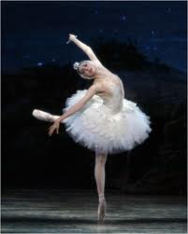
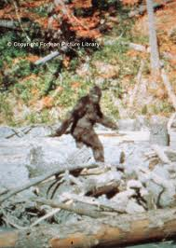
Which person is traveling ponderously?

Slide 31
Name three things that you do conscientiously.

